Slide 1
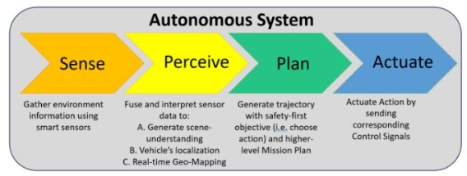
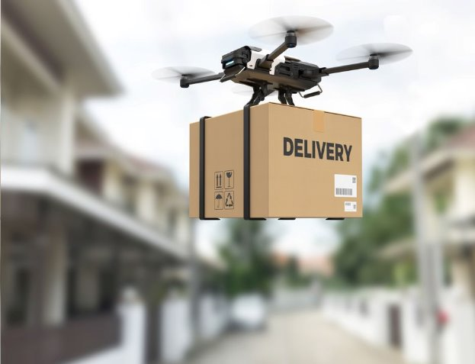
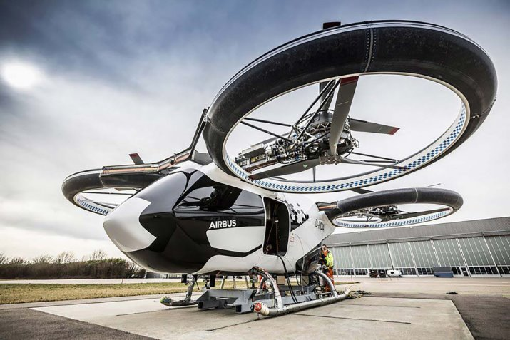
Advancing Autonomous Aerial Transport: Themes in UAV Systems R&D
Jason Noble
National University
Data Science Program
June 8, 2025
Notes:
This file presents an assertion-evidence template for making effective slides for scientific presentations. Although much about the layout and typography contrasts sharply with the defaults of PowerPoint, these changes are done so to make the slides more effective at communicating technical information. The design advocated by this template arises from Chapter 4 of The Craft of Scientific Presentations, 2nd edition (Springer, 2013). The homepage for this template exists at the following website:
http://writing.engr.psu.edu/assertion_evidence.html
Right now you are viewing the notes pages. To work on the slides, click on “Slide” under “View.” Tip: When creating a new presentation, save this file as the name of your presentation. Warning: You are more than welcome to use this template for your presentation slides. You may not, though, distribute this template for profit or distribute this template without giving credit to the source: http://writing.engr.psu.edu/
This slide is for the title slide of a presentation. Consider inserting an image that helps orient the audience to the title. You should not leave this slide until the audience feel comfortable with the title. Forcing yourself to spend more time with this slide is good because a common mistake in presentations is to leave the title slide too soon. Because of this mistake, many in the audience do not have the chance to comprehend the key details of the title. See pages 172-184 in The Craft of Scientific Presentations, 2nd ed. (CSP).
This template shows one layout for the slide. You might want to rearrange the placement of the body’s wording to accommodate a different sized image. On the next slide is a sample title slide. You should delete the examples after you create your own slides.

Slide 2
Fully autonomous UAVs will requires adaptive systems to handle uncertainty without humans.
Flight state analysis
Task analysis
Onboard optimization
Task Info
START
Local optimization
UAV state
Conflict analysis
Online optimization
Conflict coordination
Notes:
Mapping slide for the presentation (note that a background slide or a slide justifying the importance might precede this slide). A common mistake with mapping slides is to give the audience simply an unmemorable bulleted list of topics (including the names “Introduction” and “Conclusion” and “Questions”). Such a list is quickly forgotten after the slide is removed.
On a mapping slide, take the opportunity to show a key image or perhaps a representative image for each major section of the presentation. In the second case, each image would be repeated on the first visual of the corresponding section and would remind the audience that they have arrived to a major section of the presentation’s middle.
In regards to the names “Introduction” and “Conclusion,” every talk has those sections, and the names are ignored by audiences. So why state them? Also, for the divisions that you do have, find a logical and parallel grouping. Note that groups of two’s, three’s, and four’s are much easier to remember and are not so nearly intimidating as groups of five’s, six’s, and seven’s. See the discussion of mapping slides in The Craft of Scientific Presentations, 2nd ed. (pages 177-181).

Slide 3
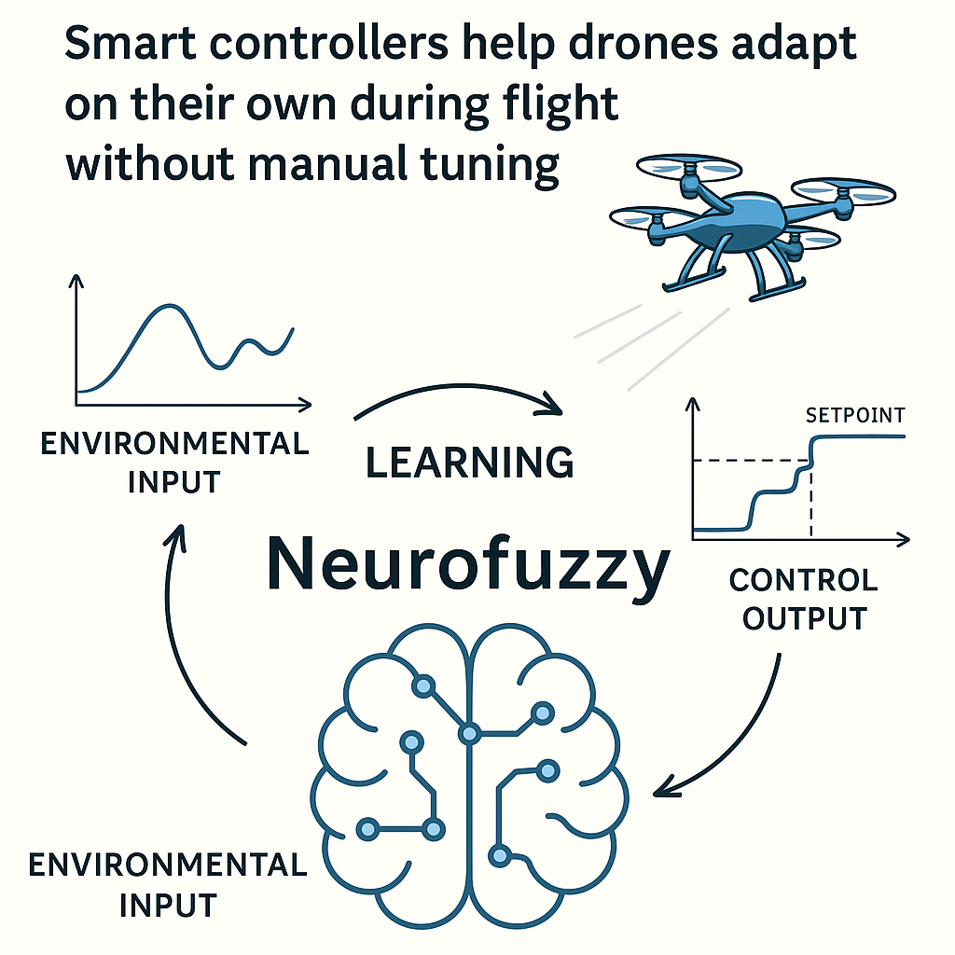
Smart controllers help drones adapt on their own during flight without manual tuning.
Notes:
Sample slide from the middle of a presentation. Notice how animation works to allow the speaker to present fairly complex connections in a way that the audience can digest. Notice how the arrows show connections—something that bullets could not achieve.
Reference
This slide is a composite slide from a number of mechanical engineering seniors in ME 4006, a laboratory course at Virginia Tech. These presentations occurred during the Fall 2004 semester.

Slide 4
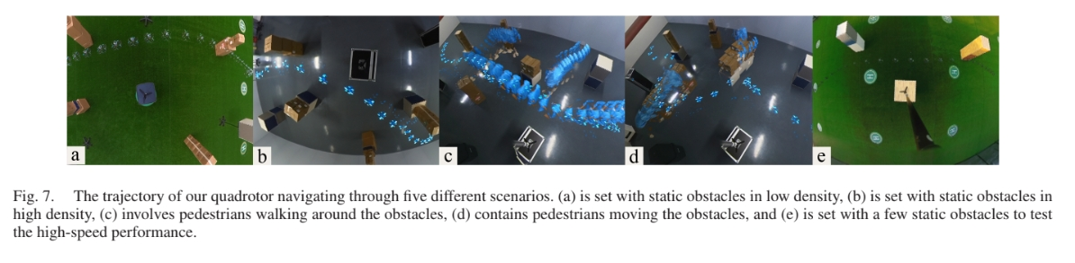
Reinforcement learning-based models outperform traditional systems in obstacle avoidance and trajectory optimization.
The drone path through five different scenarios:
(a) static obstacles/ (b) static obstacles/ (c) static and (d) obstacles are (e) limited obstacles
low density high density dynamic obstacles moving for high-speed
Performance run
Notes:
Sample mapping slide.
Reference:
Katrina Aspmo, Torunn Berg, and Grethe Wibetoe, “Atmospheric Mercury Depletion Events (AMDEs) in Polar Regions During Arctic Spring,” presentation (Oslo, Norway: University of Oslo, 16 June 2004).

Slide 5
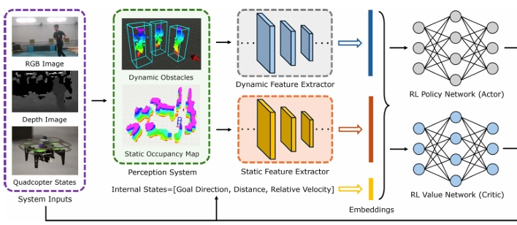
Deep reinforcement learning optimizes computational task offloading in dynamic networks.
Deployment
Training
Simulation
Hybrid Transformer-based Multi-agent Reinforcement Learning
Notes:
Body slide from the third section of the presentation’s middle. For the first body slide of this third section, consider repeating the corresponding image from the mapping slide. Use the headline to say state an assertion about this topic. In the body of the slide, support that headline with images and with needed callouts. See Chapter 4 of The Craft of Scientific Presentations, 2nd ed..
This slide shows one orientation for the image and text in the body of the slide. Other orientations appear in this template. Choose the orientation that best supports your headline assertion.

Slide 6
Multi-UAV air traffic management relies on predictive policies and spatial classification policies for "novel states".
Data
Exploitation
Learned Policy
&
Exploration Policy
Actions
New state
Reward
Environment
Notes:
Sample slide from second section of the presentation’s middle. The image was such that there was no need for subordinate descriptions.
Reference:
Jared Rochester, “Three Primary Products of an Explosive,” presentation (Aberdeen, MD: US Army Research Laboratory, 5 December 2005).

Slide 7
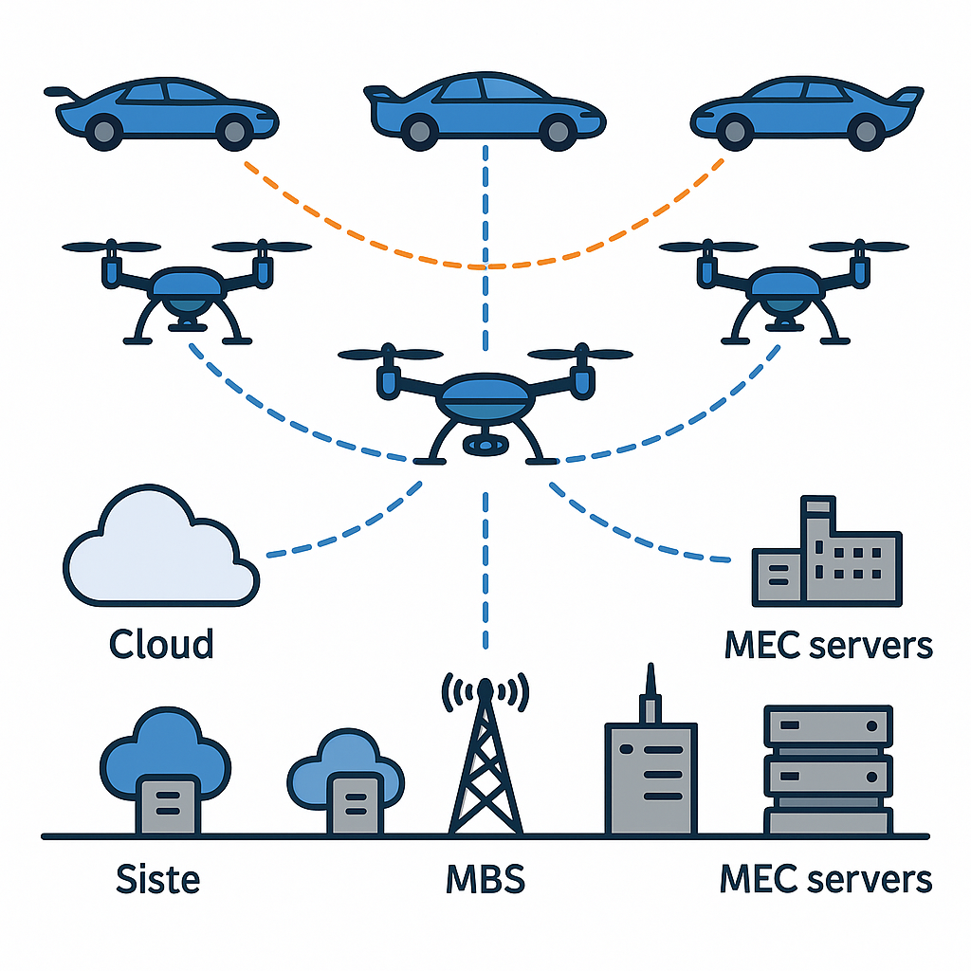
Coordinating UAV fleets requires decentralized control informed by local observations.
Fog
MBS
MEC servers
Cloud
Notes:
Body slide from the first section of the presentation’s middle. Consider having the first-topic image from the mapping slide repeated here. Use the headline (no more than two lines) to make an assertion about this topic. In the body of the slide, support that headline with images and with words, if necessary. See Chapter 4 of The Craft of Scientific Presentations, 2nd ed.
This slide shows one orientation for the image and text in the body of the slide. Other orientations appear in this template. Choose the one that best supports your headline assertion.
Some institutions will insist that you place an institutional logo on each slide. Other institutions recommend a logo on the first slide and the last. If you do place a logo on each slide, make sure that logo is at the bottom of the slide rather than the top. Placing the logo at the top (the place on a slide that receives the most emphasis) shifts the emphasis away from the work.

Slide 8
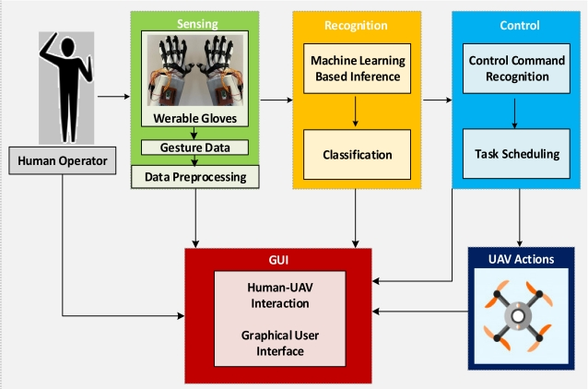
Gesture-based interfaces and cognitive load analysis offer real-time control and dynamic task allocation.
Notes:
Body slide from the second section of the presentation’s middle. For the first body slide of this second section, consider repeating the corresponding image (or equation) from the mapping slide. Use the headline to make an assertion about this topic. In the body of the slide, support that headline assertion with images and needed callouts. See Chapter 4 of The Craft of Scientific Presentations, 2nd ed.
This slide shows one orientation for the image and text in the body of the slide. Other orientations appear in this template. Choose the orientation that best supports your headline assertion.

Slide 9
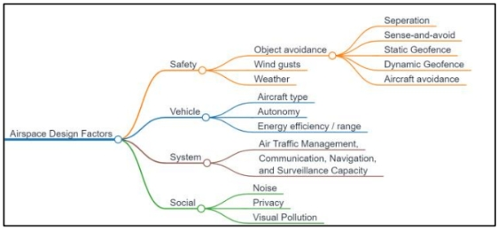
A holistic framework combining autonomy, learning, simulation and coordination is essential for scalable AAM.
Notes:
Body slide from the third section of the presentation’s middle. For the first body slide of this third section, consider repeating the corresponding image from the mapping slide. Use the headline to say state an assertion about this topic. In the body of the slide, support that headline with images and with needed callouts. See Chapter 4 of The Craft of Scientific Presentations, 2nd ed..
This slide shows one orientation for the image and text in the body of the slide. Other orientations appear in this template. Choose the orientation that best supports your headline assertion.

Slide 10
References
Fan, X., Lu, M., Xu, B., & Lu, P. (2025). Flying in Highly Dynamic Environments With End-to-End Learning Approach. IEEE Robotics
and Automation Letters, Robotics and Automation Letters, IEEE, IEEE Robot. Autom. Lett, 10(4), 3851–3858.
https://doi.org/10.1109/LRA.2025.3547306
Jung, H., & Kim, Y. (2024). Maneuver-Conditioned Decision Transformer for Tactical in-Flight Decision-Making. IEEE Robotics
and Automation Letters, Robotics and Automation Letters, IEEE, IEEE Robot. Autom. Lett, 9(6), 5322–5329.
https://doi.org/10.1109/LRA.2024.3391691
Planke, L. J., Lim, Y., Gardi, A., Sabatini, R., Kistan, T., & Ezer, N. (2020). A Cyber-Physical-Human System for One-to-Many UAS
Operations: Cognitive Load Analysis. Sensors (Basel, Switzerland), 20(19). https://doi.org/10.3390/s20195467
Mishra, S., & Palanisamy, P. (2023). Autonomous Advanced Aerial Mobility—An End-to-End Autonomy Framework for UAVs and
Beyond. IEEE Access, Access, IEEE, 11, 136318–136349. https://doi.org/10.1109/ACCESS.2023.3339631
Uddin, A., Sakr, A. H., & Zhang, N. (2025). Adaptive Prioritization and Task Offloading in Vehicular Edge Computing
Through Deep Reinforcement Learning. IEEE Transactions on Vehicular Technology, Vehicular Technology, IEEE Transactions on, IEEE Trans. Veh. Technol, 74(3), 5038–5052. https://doi.org/10.1109/TVT.2024.3499962
Xu, Z., Han, X., Shen, H., Jin, H., & Shimada, K. (2025). NavRL: Learning safe flight in dynamic environments. IEEE Robotics and
Automation Letters, 10(4), 3668–3675. https://doi.org/10.1109/LRA.2025.3546069
Yang, J., Yang, F., Xu, X., Zhang, K., Wang, X., & Yang, G. (2025). C3R: A Novel Classification Model-Based Coordination Method for
Online Conflict Resolution of Multiple Unmanned Aerial Vehicles. IEEE Transactions on Vehicular Technology, Vehicular
Technology, IEEE Transactions on, IEEE Trans. Veh. Technol, 74(2), 2366–2378. https://doi.org/10.1109/TVT.2024.3420154
Yoo, M., Na, Y., Song, H., Kim, G., Yun, J., Kim, S., Moon, C., & Jo, K. (2022). Motion Estimation and Hand Gesture Recognition-Based
Human-UAV Interaction Approach in Real Time. Sensors (Basel, Switzerland), 22(7). https://doi.org/10.3390/s22072513
Notes:
10
This slide was created by Lauren Sawarynski, who earned her B.S. in Bioengineering at Penn State in 2010 and is now in the Physician Assistant Program at Yale Medical School.
Reference for data:
J.K. Lai, M.A. Martin, R. Meyricke, T. O’neill, and S. Roberts (2007, February). Factors associated with short-term hospital readmission rates for breast cancer patients in Western Australia: an observational study. J Am Coll Surg. 204 (2):193-200.
10

